Slide 1

ECE 281 Lesson 11
Maj Walchko
1

Slide 2
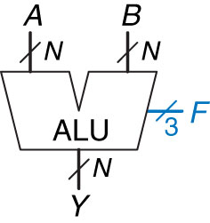
ALU – Block Diagram
ALU: Arithmetic Logic Unit
Combine Math and Logic
Heart of most computers
Has 7 functions
Control Signals
F₂ | F₁ | F₀ | Y
0 | 0 | 0 | A and B
0 | 0 | 1 | A or B
0 | 1 | 0 | A + B
0 | 1 | 1 | Not Used
1 | 0 | 0 | A and B’
1 | 0 | 1 | A or B’
1 | 1 | 0 | A – B
1 | 1 | 1 | set <

Slide 3

ALU – Block Diagram
Build an ALU with logic Functions:
What do we need?
Adder
Inverter
And
Or
Mux
Comparator
Control Signals
F₂ | F₁ | F₀ | Y
0 | 0 | 0 | A and B
0 | 0 | 1 | A or B
0 | 1 | 0 | A + B
0 | 1 | 1 | Not Used
1 | 0 | 0 | A and B’
1 | 0 | 1 | A or B’
1 | 1 | 0 | A – B
1 | 1 | 1 | set <
How would we design this? Let’s draw it out …

Slide 4
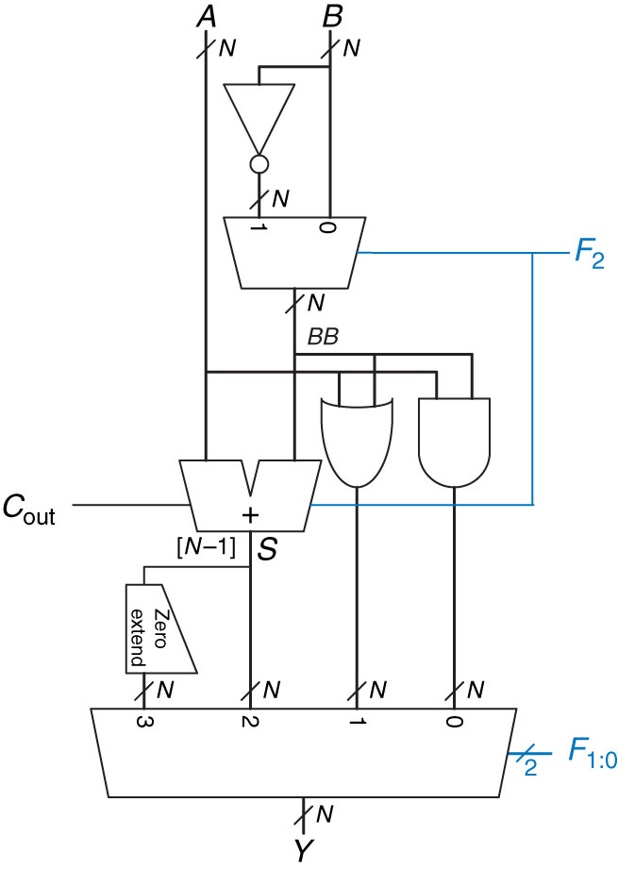
ALU

Slide 5
Multiplication in Binary
An ALU can add and subtract in binary
How do we multiply in Binary?
 |  | 1 | 0 | 1
 | X | 0 | 1 | 1 |  | X
 |  |  |  |  |  | ➔
By adding and shifting, we can multiply numbers

Slide 6
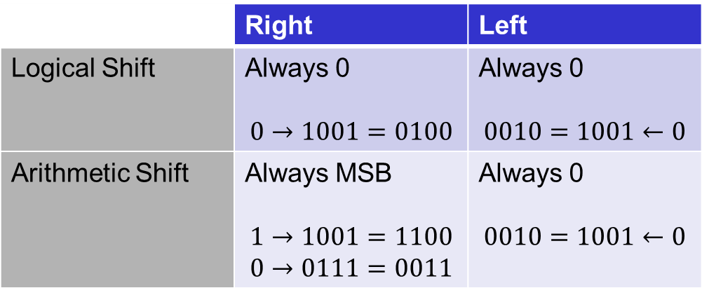
Shift Summary
 | Right | Left
Logical Shift | Always 0 $$0→1001=0100$$ | Always 0 $$0010=1001←0$$
Arithmetic Shift | Always MSB $$1→1001=1100$$ $$0→0111=0011$$ | Always 0 $$0010=1001←0$$
Shifter:
Logical Shift Right/Left – fill empty spots with 0’s
Arithmetic Shift Right (ASR) – when shifting right, fills empty spots with MSB (to preserve sign)
ASL is same as LSL

Slide 7
Rotator
Rotator:
SHIFT from one end to the other
# that falls off one end attaches to other end
0 0 1 0
0 0 0 1 0
0 0 1 0
1 0 1 0 0

Slide 8
Shamt
Shamt:
Shift Amount
Why is this useful?
Helps multiply and divide!

Slide 9
Examples
100110 ➔ Logical Shift Right ➔
What if it was an Arithmetic Shift Right on a signed number?
100110 ➔ Arithmetic Shift Right ➔
100110 ➔ Logical/Arithmetic Shift Left (6-Bit System) ➔
00100110 ➔ Logical/Arithmetic Shift Left (8-Bit System)➔

Slide 10

Practice
Practice:
Use Only two 2:1 mux to create a 3:1 mux:
$AB=00=>I_{0}$
$AB=01=>I_{1}$
$AB=1X=>I_{2}$

Slide 11
Quiz
Quiz: 5 Min
http://www.online-stopwatch.com/full-screen-stopwatch/

Slide 12

12

Slide 13
Shifter
Shifter:
Logical Shift Right/Left – fill empty spots with 0’s
Arithmetic Shift Right (ASR) – when shifting right, fills empty spots with MSB (to preserve sign)
ASL is same as LSL

